Slide 1



Slide 2

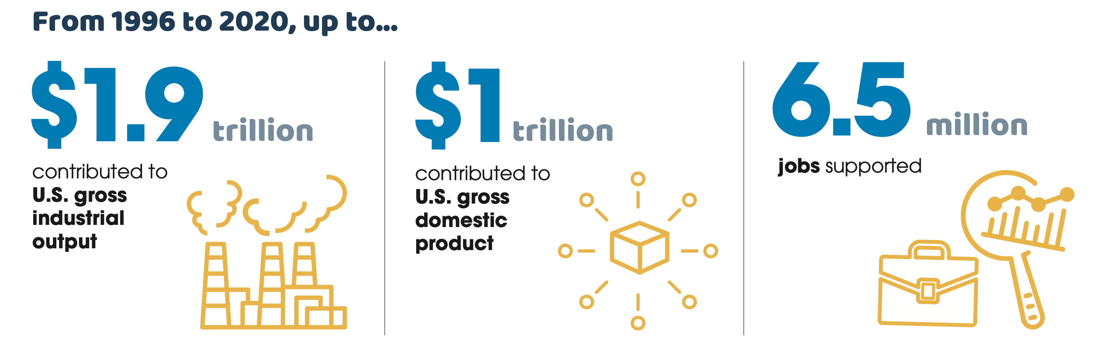
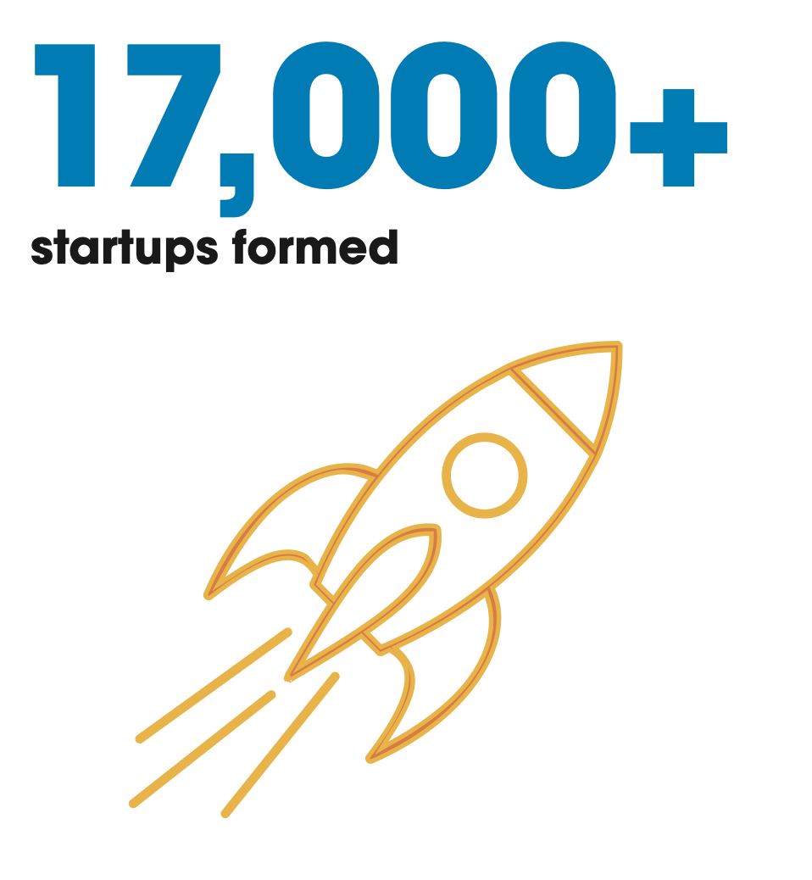
Academic Start-Ups:
Driving Innovation & Economic Growth
- Association of University Technology Managers (AUTM)

Slide 3

Most University Inventions Never
Translate into Start-Ups
24,140 University Disclosures in 2022
998 University Start-ups Formed in 2022
- AUTM surveys
Disclosures
40% of University Start-Ups are ”Walking Dead”
7% never get started
R & D
- Nat. Biotech, 2020
Academia
Start-Up

Slide 4


The Problem: Faculty Have No Time …
Legal
Documents?
Insurance
Payroll, Accounting, Taxes?
Research
Advising
Cap Table?
Patent Filed
Teaching
Employee Benefits?
R & D
… and Little Know-How
Service

Slide 5

Starting a Company is Too Big of a Push
Faculty have too much to learn
They don’t know where to start
They need push-button solutions

Slide 6

Our Mission
Assist
Assist academic faculty in running a small business, so they can focus on the science of their discoveries.
Accelerate
Accelerate new discoveries to consumers and patients in need
Capitalize
Capitalize upon the growth in biotechnology investment in the Philadelphia region (and beyond)

Slide 7

StreamLaunch makes it easy
BO, WC
Insurance
Payroll
Accounting
On-Boarding
Employee Benefits
Registrations
Taxes
Legal
Documents
Tax Credit
Grant Management
Company
Formation
Off-Boarding

Slide 8

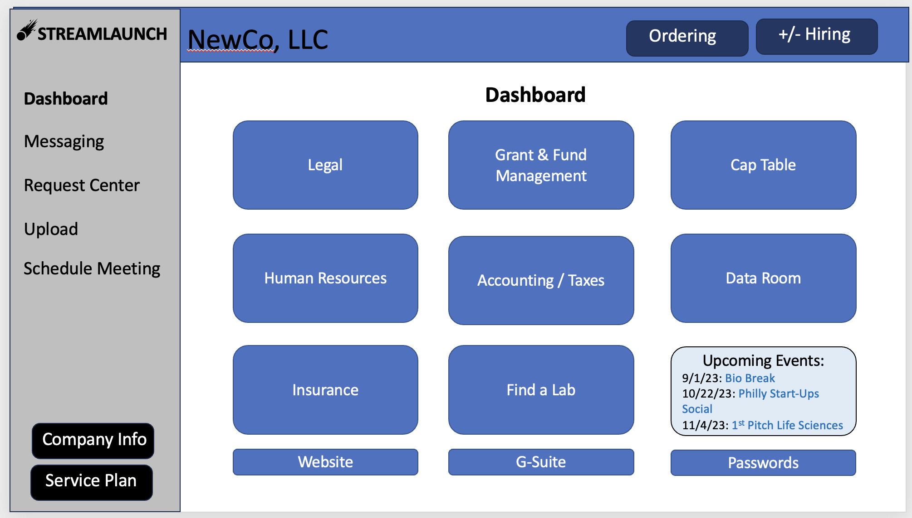
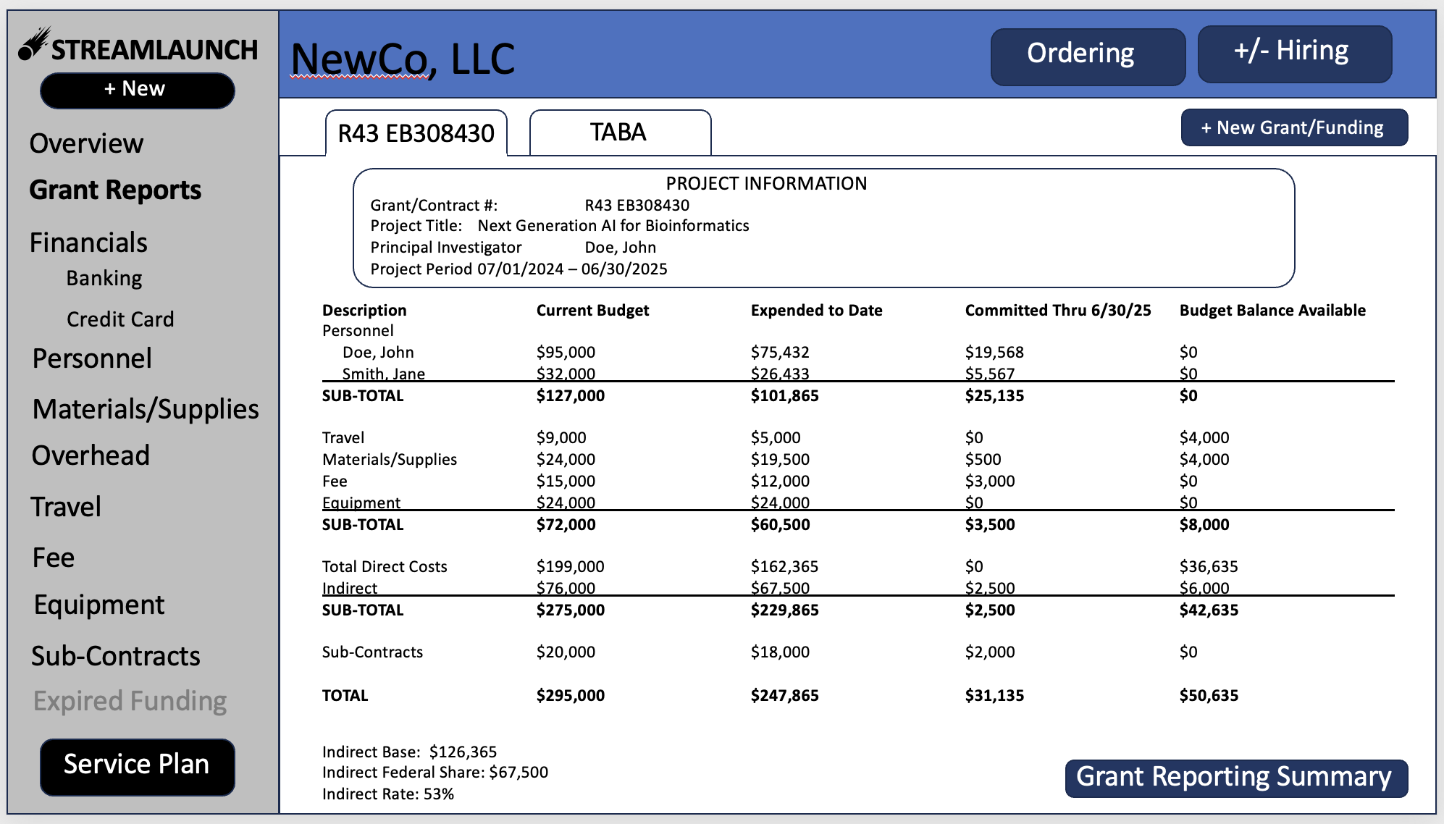
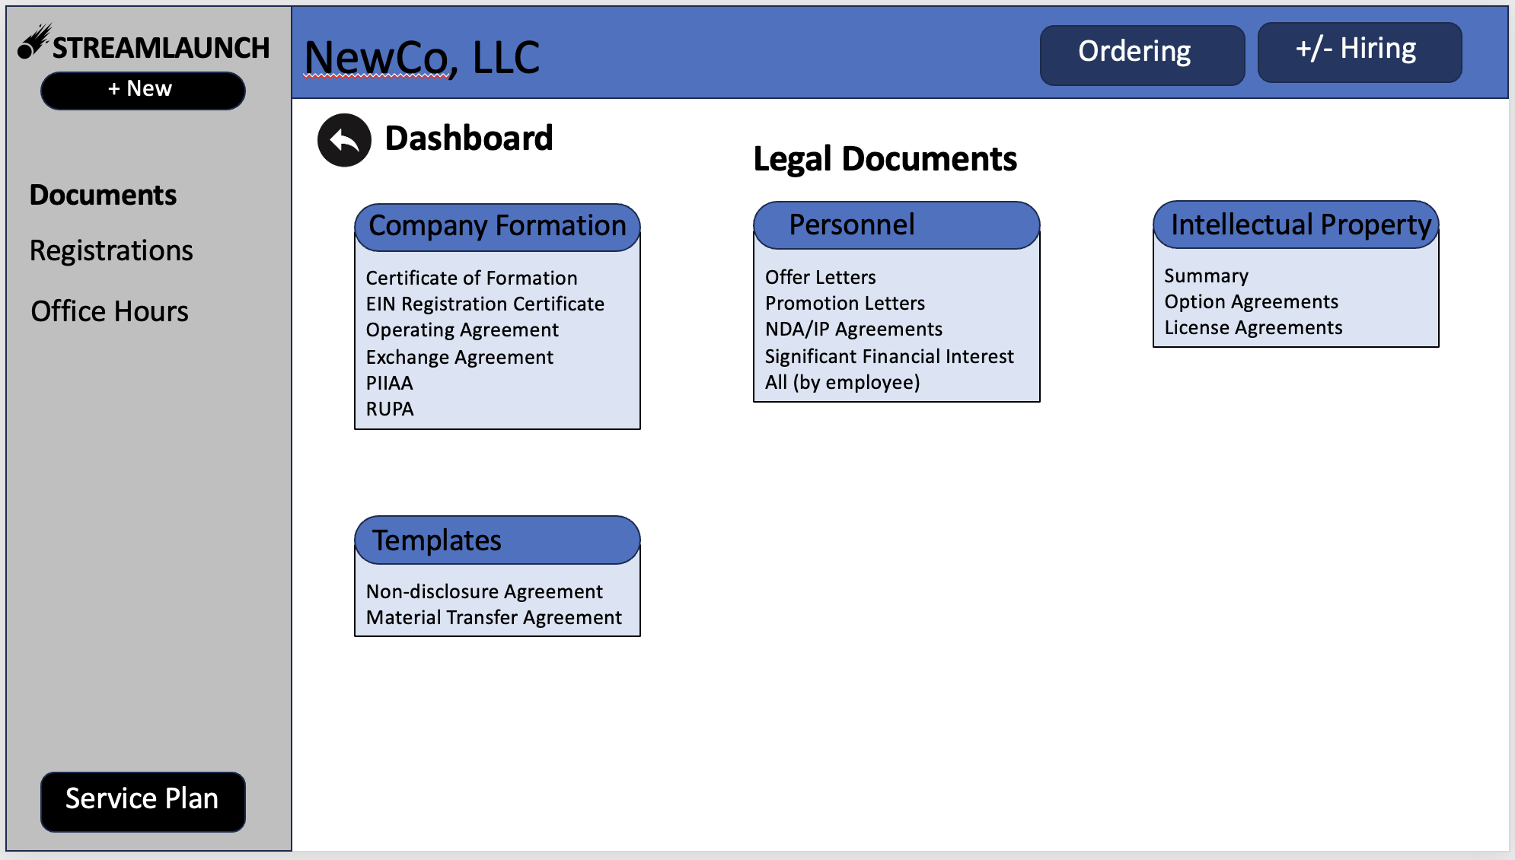
StreamLaunch App
- Streamlined User Interface
- Grant Management
- Document Organizer
… and so much more
All the functionality you need to run a start-up in a single app

Slide 9

Letting faculty focus on what they are good at …
… the Science / Writing Grants

Slide 10
Key Initial Offerings
In Addition to Company Formation Logistics
Human Resources: Automate payroll & employee management systems. Assist, as needed in recruitment for initial key positions
Legal expertise: On demand support from vetted counsel – from the very start of the journey
Accounting: Automated accounting expertise for monthly reports, annual tax return, and on demand planning
Lab Space (if needed): Catalogued connections to local lab space (wet & dry) to accommodate growth
Grant Management: Automated financial record keeping and reporting for SBIRs and STTRs
Network Access: Talent, EIRs, and Venture Community access

Slide 11
Funding Model
SBIR Phase I: $25,000 Service Fee
Overhead Cost: ~$45,000 (2 employees)
SBIR Phase II: $75,000/yr Service Fee
Overhead Cost: ~$70,000/yr (4 employees)
Start-Up Fee: 4% Equity + pass-through costs
Annual Cost: ~$500/yr
Post-Phase II: TBD
Overhead Expense: TBD

Slide 12
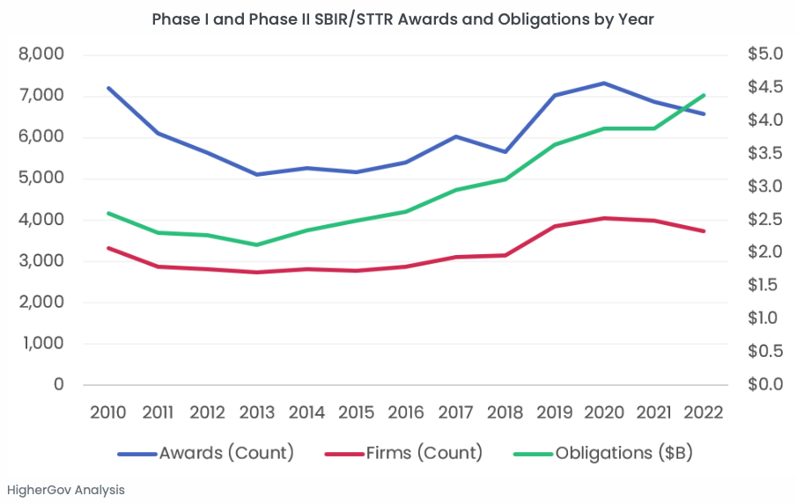
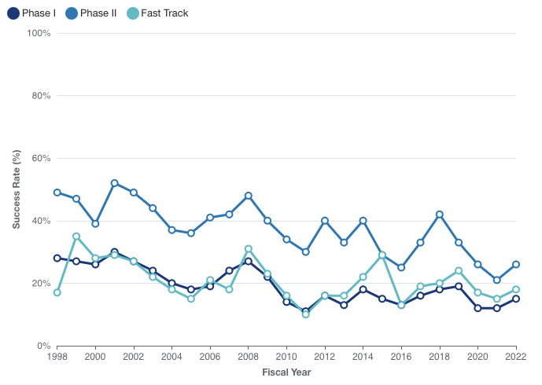
America’s Seed Fund
SBIRs provide high probability mechanism for non-dilutive funding
Only 0.05% of start-ups raise venture capital

Slide 13





Secondary Customers & Partners
Patients
  More new treatments in development
  Accelerated path to bring new drugs to market
Funders/Investors
  “Eyes” into new University start-ups.
  First mover advantage
  De-risked monitoring mechanism
Universities & Health Systems
  Accelerated and more confident spin-out of start-ups.
  Alternative revenue stream
  Infrastructure poised to retain and recruit faculty
  Job Opportunities for trained Scientists
Economic Development
  Magnet for life science growth
  Filled lab & GMP spaces
  Tax revenue
Job Creation
  Hub for talent matching
  Find executives for start-ups
  Find scientists for start-ups
  Networking with other founders

Slide 14
Future Services Offered
Business Expertise: Commercialization Plans; consulting & strategy; business plans and market research; scientific consulting; license negotiations
Financing expertise: Connections with VC/Angel Investors; Up-to-date on new opportunities (eg. Biobonds, Venture Philanthropy)
Data Integrity: Expertise on data integrity & data infrastructure support; data security and password management
Hands-on help as needed
Help with licensing, grant reporting, taxes, etc

Slide 15
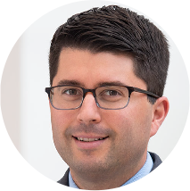
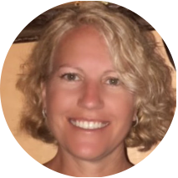

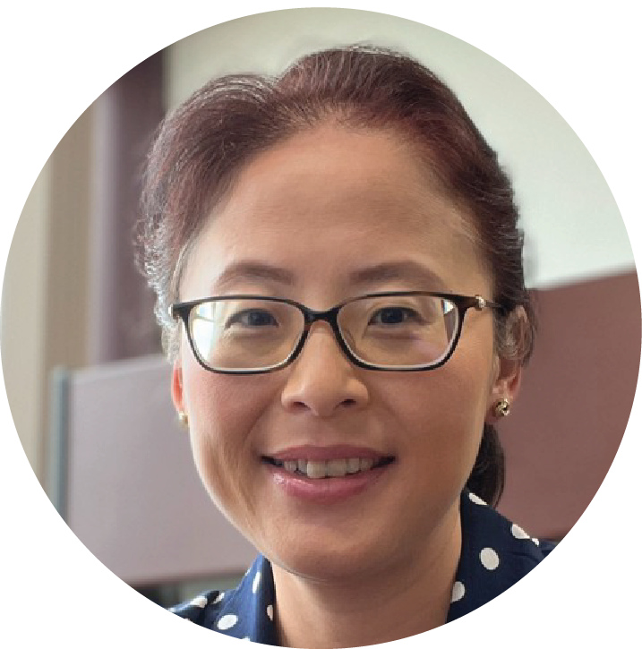
Team
Patrick Higgins
  Experience: Director, Service Line/Network Integration; Business Development
Heather Maia
  Experience: CPA (Partner/Manager); CFO
Andrew Tsourkas
  Experience: Penn faculty; Scientific Founder
Connie Zhang
  Experience: CPA; Audits / Internal Controls; Consulting

